Slide 1
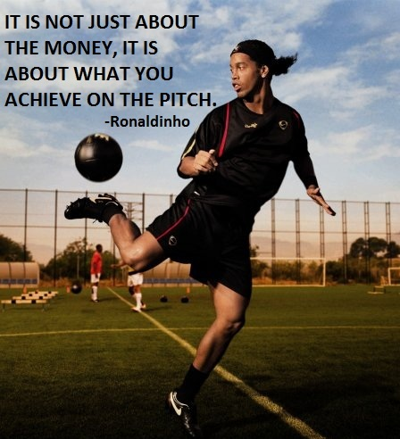
Presentation Of Learning
By: Ismael Torres

Slide 2
Algebra 2

Slide 3
Essential skill #2
Linear Functions- I can translate between any of the four faces of a Linear Function, inclusive of shifts
In my words : This means I can compare and contrast the differences between the four faces of functions and know what they are and what shifts them

Slide 4
What I know.
There are seven functions
To make a graph stretch you would need to make the coefficient “a” less than 1 to make the graph compress you would need to do the opposite
Adding or subtracting to h will cause a graph to move to the right or left
Adding or subtracting to k will cause a graph to move up or down

Slide 5
4 faces of a function
G raph
R ules
O
W ords
T able
H

Slide 6
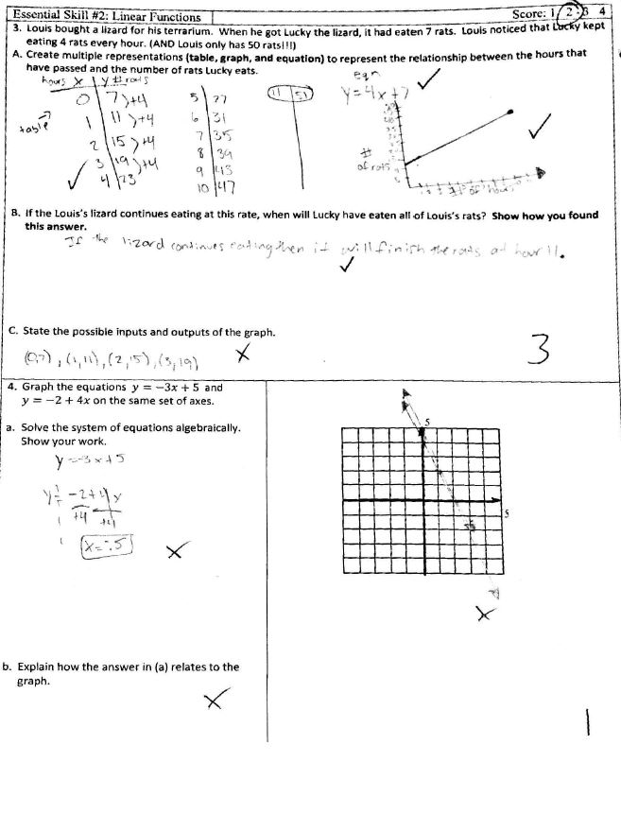
Evidence

Slide 7
Correct way to Answer this Question
Y=-3x+5 Y=-2+4x
-5 -5 +2 +2
-5=-3x +2=4x
-3 -3 4 4
X= -5/-3 =(1.66) x=2/4 =(0.5)
The two answers are related because they are the points on the graph where both lines intersect

Slide 8
What I did wrong
Didn’t read the directions
Tried graphing first

Slide 9
My understanding of the content
A function is like a machine it has an input and an output
The output is related to the input

Slide 10
English 11

Slide 11
Essential skills
Essential skill# 10- Reading Analysis (Rhetorical Devices)

Slide 12
What I know
Rhetorical Devices
What they are what they do and their function.
They are found in speeches, Essay’s, Non-Fiction stories

Slide 13
Rhetorical device
What is it?
What is their function?
Their function is to convey a message through readings to the audience.
Rhetorical devices are a type of Language/ code that the author uses to reveal a message in the readings.

Slide 14
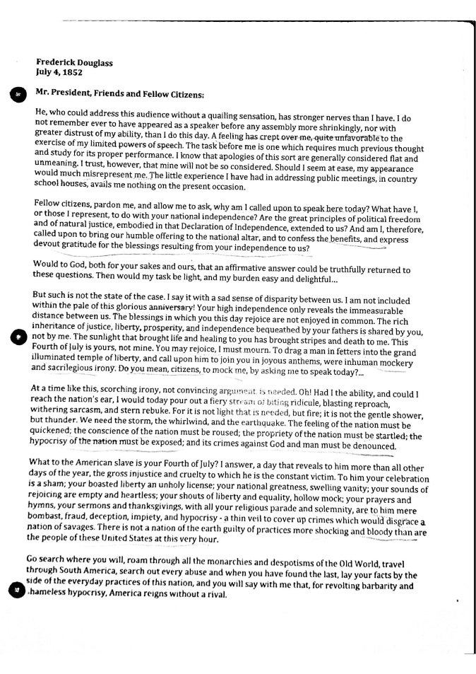
Fourth of July Speech

Slide 15
Three Quotes From the Story
Fourth of July Speech
What message they convey.
“To drag a man in fetters into the grand illuminated temple of liberty, and call upon him to join you in joyous anthems, were inhuman mockery and Sacrilegious Irony”
“To him your celebration is a sham; your boasted liberty an unholy license”
“I am not included within the pale of this glorious anniversary! Your high independence only reveals the immeasurable distance between us.”
the message that these three quotes convey is of:
Slavery
Freedom the Africans had
The way the Africans were treated at the time

Slide 16
Reflection

Slide 17
HoM strength
Connection
Saw Connection through projects in each class and making connections through class work.

Slide 18
HoM weakness
Quality
Didn’t put enough effort in the work I have turned in
Shoot for the average

Slide 19
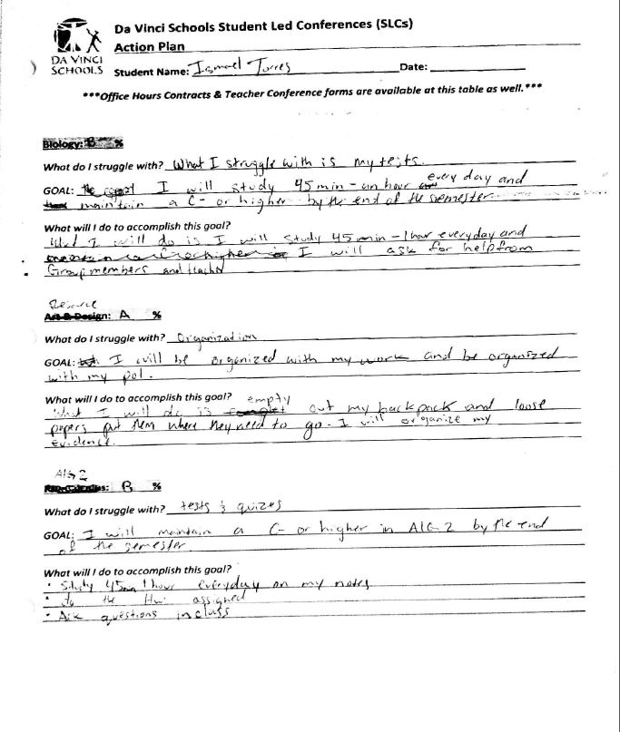
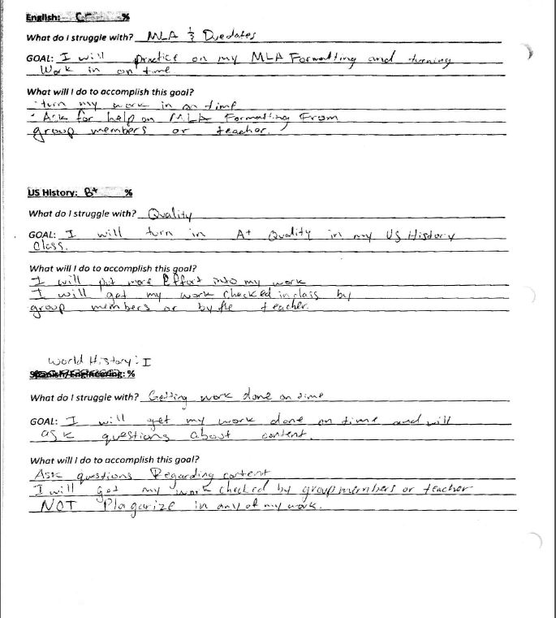
SLC Goals

Slide 20
SLC Goals
Did I meet my SLC goals?
No
My English 11
I did not turn work in on time I did not turn in A+ Quality

Slide 21
Goal for next semester
Finish the school year with no incompletes
Want to feel proud of the work I turned in
I don’t want to just shoot for the average
Always ask for help on the content.

Slide 22
Thank You for your time!!!

